Slide 1
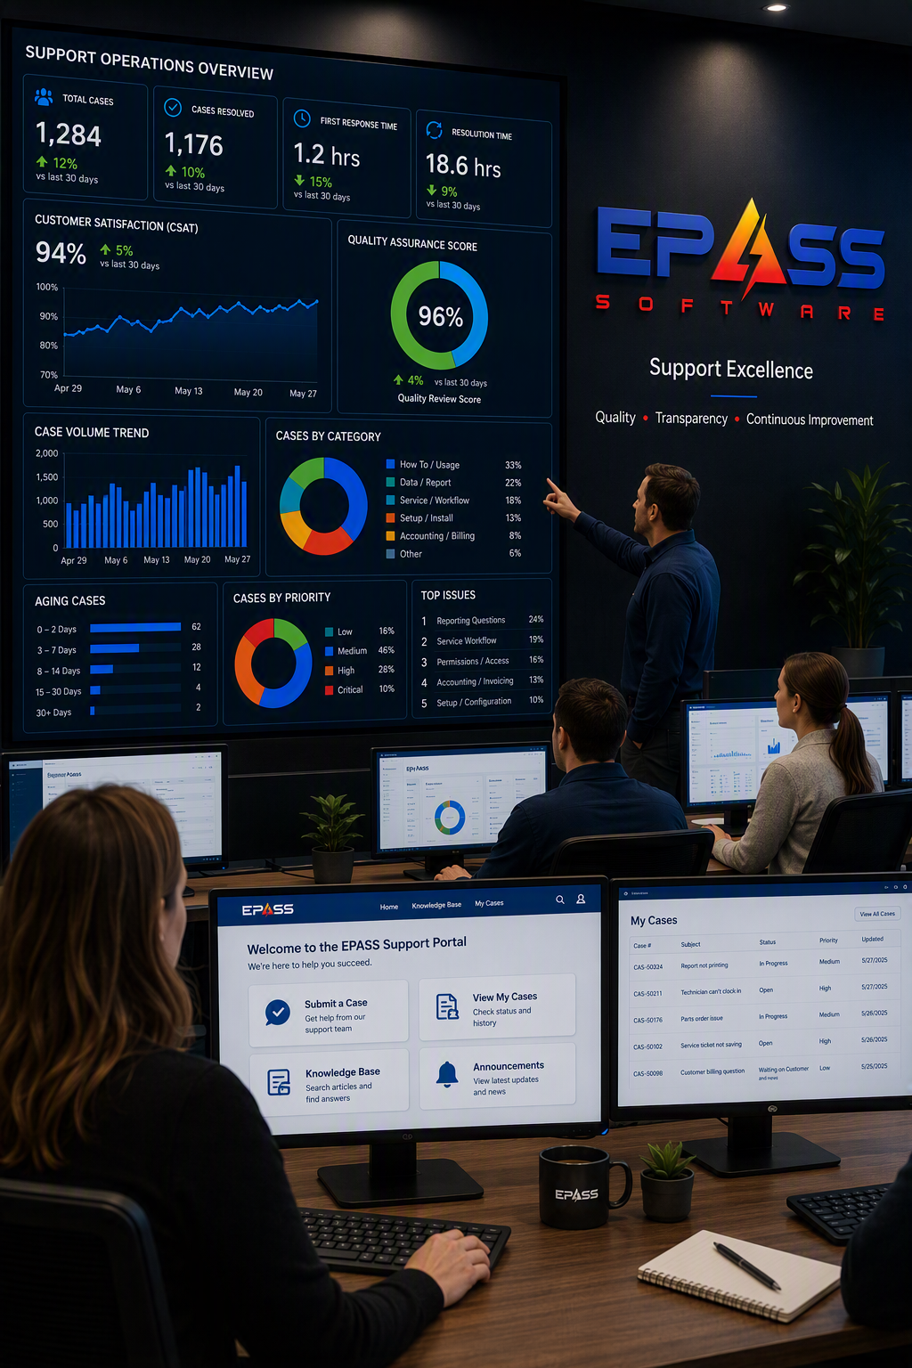
EPASS Support Update
Our Mission: Deliver an Incredible Customer Experience

Slide 2

SUPPORT PERFORMANCE AT A GLANCE
LAST 12 MONTHS
SUPPORT VOLUME
RESPONSIVENESS
SATISFACTION
LOYALTY
11,057
6,653
46 SEC
99.2%
80
CASES CLOSED
CALLS ANSWERED
AVG WAIT TIME
CSAT
tNPS
Calls answered
833 surveys received
70+ is world-class
KNOWLEDGE CREATION
435
ARTICLE MIX
QUALITY AT SCALE
TOTAL KBs WRITTEN
281
154
11K+ cases closed
with 99.2% CSAT
281 Internal Articles | 64.6%
154 External Articles | 35.4%
Notes:
Transactional Net Promoter Score
1-6 = Detractor
7-8 = Passive
9-10 = Promoter

Slide 3
THE TEAM BEHIND EVERY CASE
Three ways to reach Support, with the right expertise engaged when needed.
CONTACT SUPPORT
TIER 2
TEAM LEADS
PRIMARY TEAM
3 leads support escalations and more complex topics
@
EMAIL
Send a message to support@epass.software
FRONTLINE SUPPORT
5 technicians manage most questions, troubleshooting, and guidance
The case owner coordinates the work and keeps you informed
VALUE & ADOPTION
CUSTOMER SUCCESS
☎
PHONE
Matt helps you gain more value from EPASS and supports selected accounting escalations
Speak directly with the Support team
▣
SUPPORT PORTAL
DEPLOYMENTS & IT
IT SPECIALIST
Create, monitor, and update cases online
Anmol assists with IT-related matters and manages database and software update deployments

Slide 4
OUR COMMUNICATION COMMITMENTS
Internal service targets guide how frequently we communicate throughout the life of a case.
ACTIVE CASE UPDATE TARGETS
WHAT TO EXPECT
ALL NEW CASES
Clear follow-up expectations
CRITICAL
Every 4 business hours
✓
2
HOURS
NORMAL
Every 1 business day
✓
Updates aligned to case priority
INITIAL CONTACT TARGET
Revised expectations when timelines shift
LOW
Every 10 days
✓
Early acknowledgement confirms that the request has been received and is being reviewed.
✓
Continued communication while the case is active
AWAITING RESPONSE
Every 10 days
COMMUNICATION MATTERS

Slide 5
WHAT HAPPENS AFTER YOU SUBMIT A CASE?
Most cases follow a direct resolution path. Additional expertise is engaged when needed.
1
2
3
4
5
SUBMIT
REVIEW
INVESTIGATE
RESOLVE
CONFIRM
Your request enters the support queue
A technician confirms scope and ownership
The team gathers context and troubleshoots
Guidance or a solution is provided
Outcome and next steps are communicated
WHEN NEEDED
ESCALATE & COLLABORATE
PRODUCT FOLLOW-THROUGH
The case owner consults the team. Team Leads have direct access to Development and review issues frequently.
Confirmed bugs and feature requests are logged, triaged, and assigned for development review

Slide 6
INVESTING IN SUPPORT QUALITY
A structured program designed to strengthen every customer interaction
HOW THE PROGRAM WORKS
WHAT EPASS USERS CAN EXPECT
OUR GOAL
A more consistent, effective, and customer-focused support experience
Review
CLEARER COMMUNICATION
1
A representative selection of support cases is reviewed regularly
✓
Better explanations, proactive follow-up, and clearer expectations
Learn
GREATER CONSISTENCY
Quality reviews help us turn real support interactions into coaching, shared best practices, and service improvements
2
The team identifies strengths, coaching opportunities, and recurring themes
✓
A shared quality standard across support interactions
Improve
STRONGER RESOLUTION
3
Insights are applied through training, shared practices, and process updates
✓
Structured troubleshooting and better knowledge sharing
CONTINUOUS IMPROVEMENT TO ACHIEVE SUCCESSFUL SUPPORT OUTCOMES
Deliver
ONGOING IMPROVEMENT
4
Customers receive clearer, more consistent, and more effective support
✓
Interaction trends inform training, processes, and product feedback

Slide 7
THE EPASS SUPPORT PORTAL
Manage support cases and access self-service knowledge in one place.
SUPPORT AT YOUR FINGERTIPS
GET STARTED
1
Create an account
+
✓
↻
support.epass.software/signup
CREATE CASES
MONITOR
UPDATE
Submit a new support request.
Track status and review history.
Add details and respond to Support.
2
User your company email
Your email domain links you to your company
EPASS KNOWLEDGE BASE
BROWSE + SEARCH
3
Sign in
KB
support.epass.software
Browse or search customer-facing articles for answers, guidance, and product information.
By default, you see your own cases. Support can enable company-wide visibility.
UP NEXT: LIVE SUPPORT PORTAL DEMO

