Slide 1

Data Hygiene &
Data Integrity
Keeping your EPASS data under control

Slide 2
Data Hygiene
Data hygiene is the ongoing process of keeping a database clean, accurate, and free of errors by finding and fixing incorrect, duplicate, or outdated information.
Why should you care?
  Reduces errors and saves time by not having to look past bad data
  Good data in = good data out
  Identify issues and trends early

Slide 3
Data Integrity
Data integrity is the assurance that information remains accurate, consistent, and reliable throughout its entire lifecycle—from creation and storage to retrieval and deletion
Once you’ve cleaned your data, how do you maintain it?

Slide 4
Data Sources
Where is your data coming from?
  Buying groups
  AVB / RetailDeck / Nationwide feed
  Supplier price sheets
  Manual price list imports
  Rogue users

Slide 5
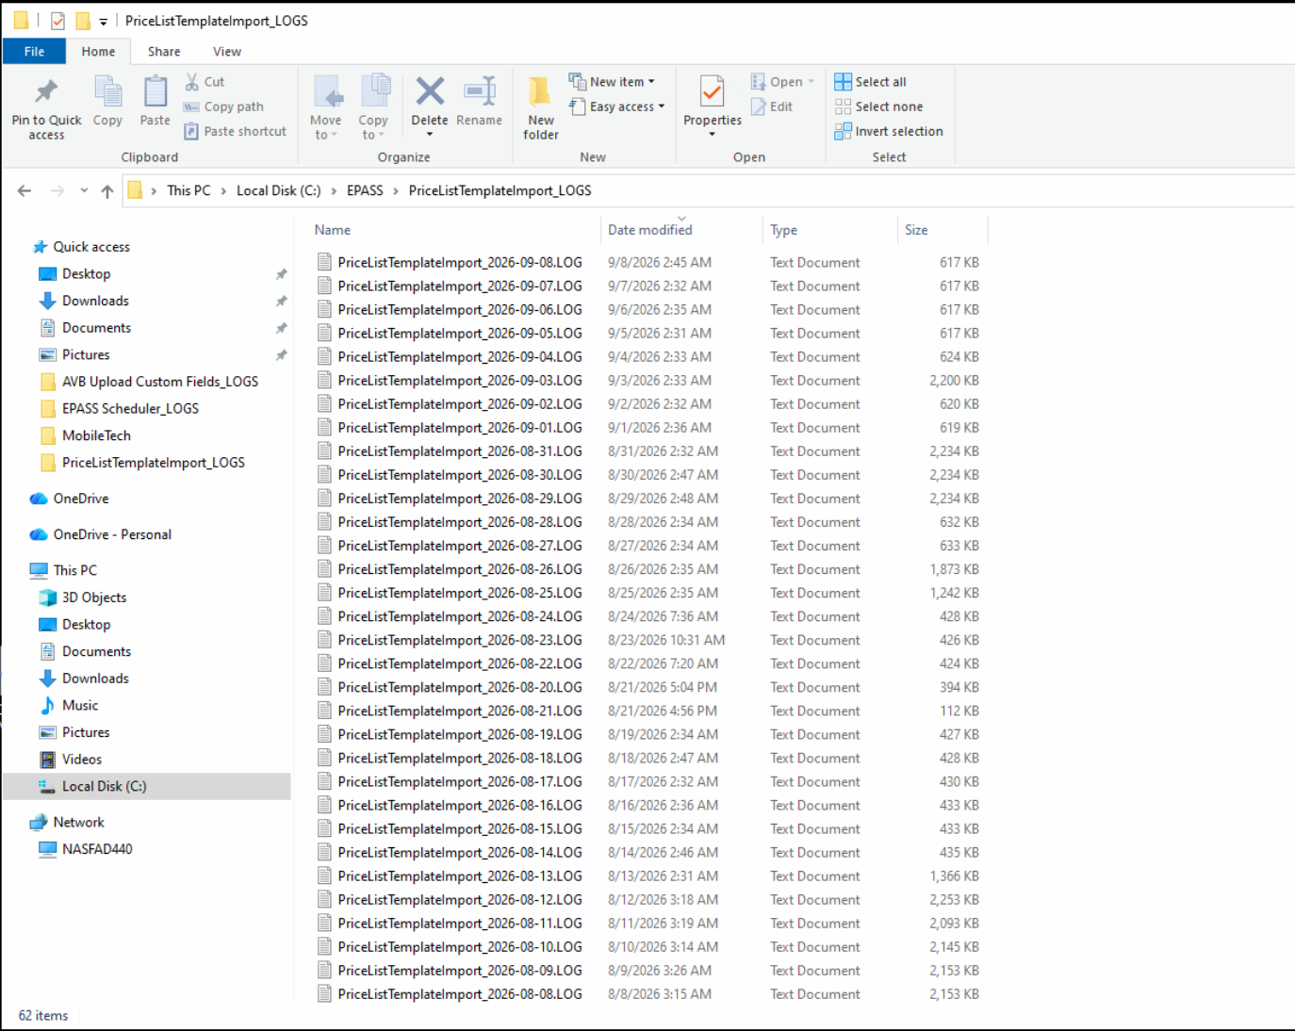
Log Files
Log files for daily automated imports are on the server. Talk to your IT about easy access
Log files for manual user imports are stored locally:
EPASS\PriceListTemplateImport_LOGS

Slide 6
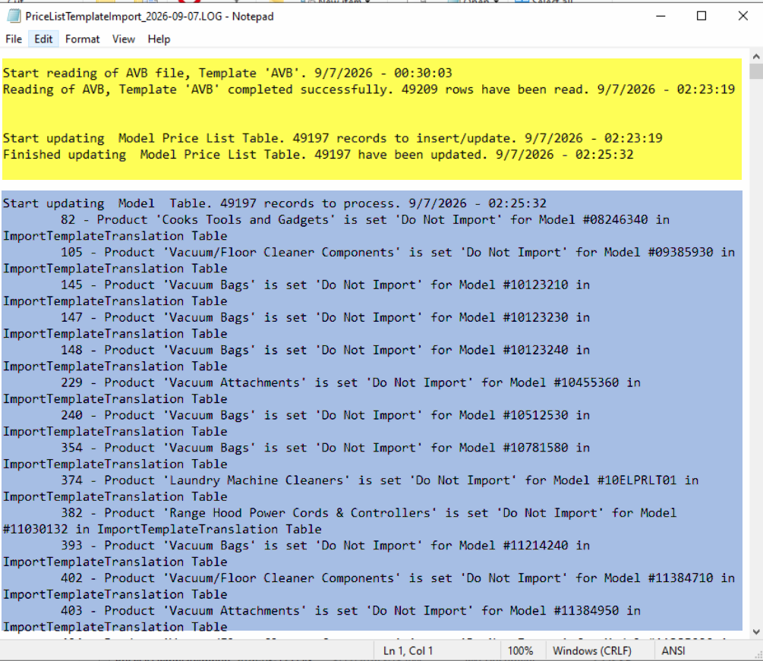
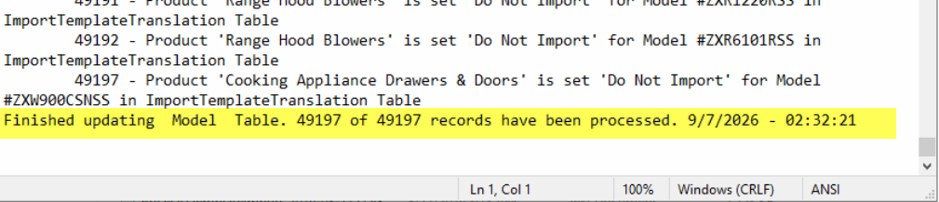
Log Files – How to Read Them

Slide 7
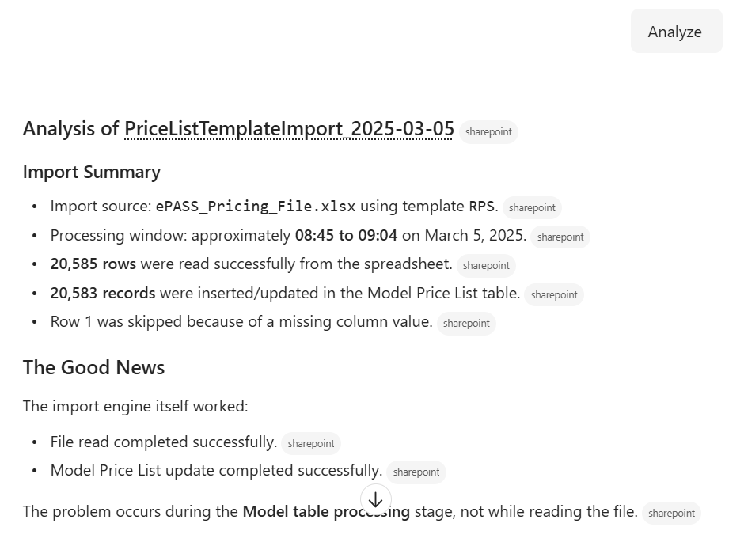
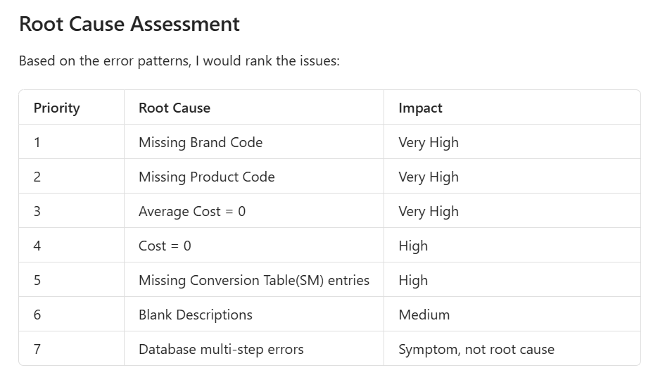
Log Files – Opportunity for AI?

Slide 8
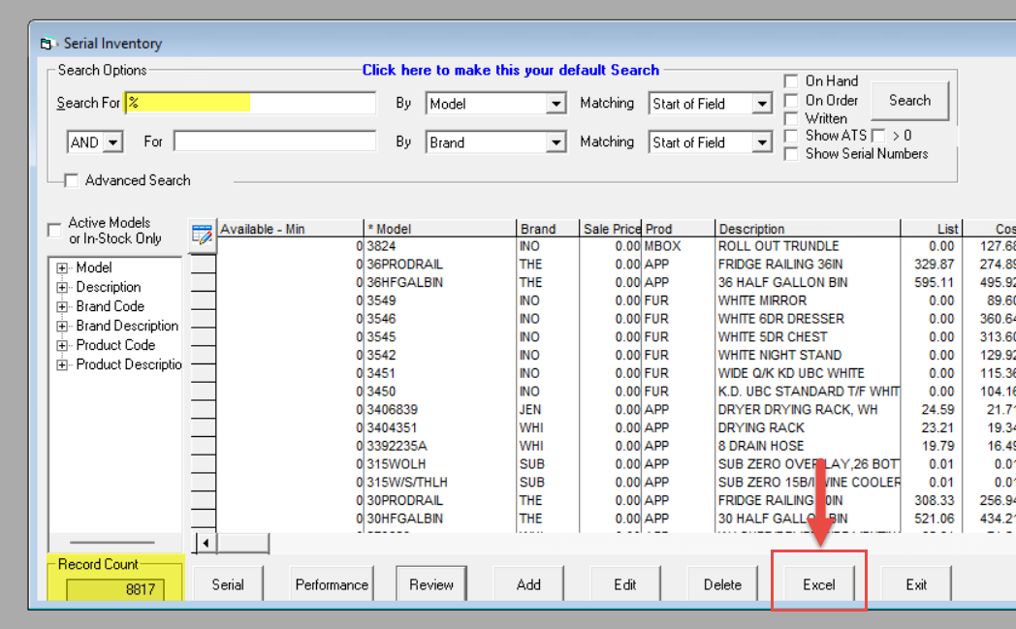
Serial Maintenance
The basic serial maintenance screen can be used to quickly export data sets.
Use the % character to get all results in a search field
Click the Excel button to export to a spreadsheet

Slide 9
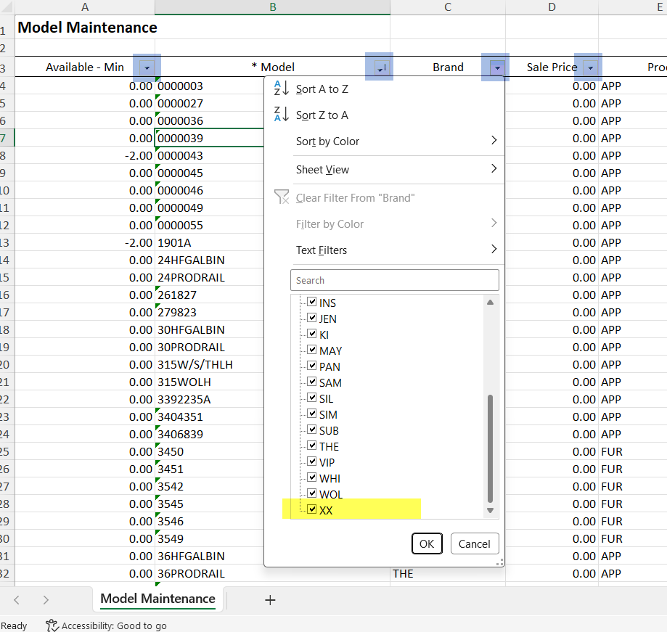
Excel Export
Use Excel filters to help look for potential data issues in large data sets.
  Do all the categories make sense?
  Are there any blanks?
  Does everything have a price?

Slide 10
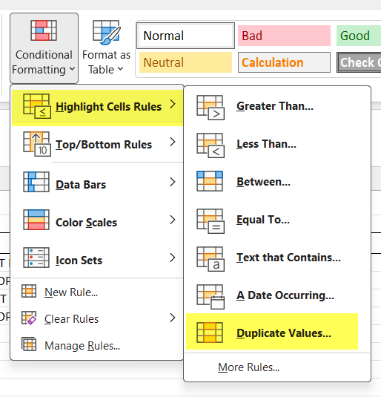
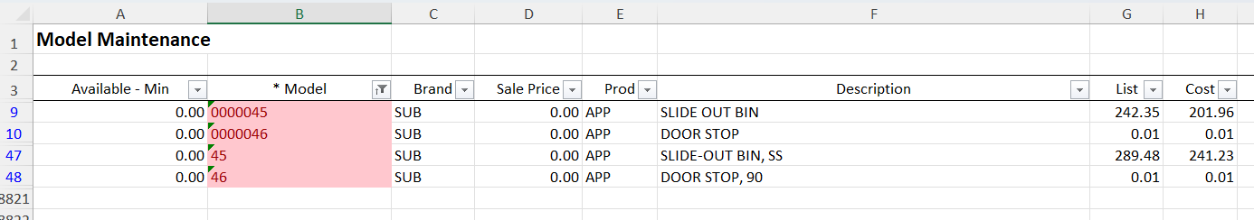
Excel Export - Use conditional formatting to help find duplicates

Slide 11
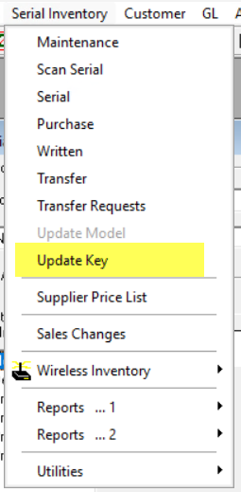
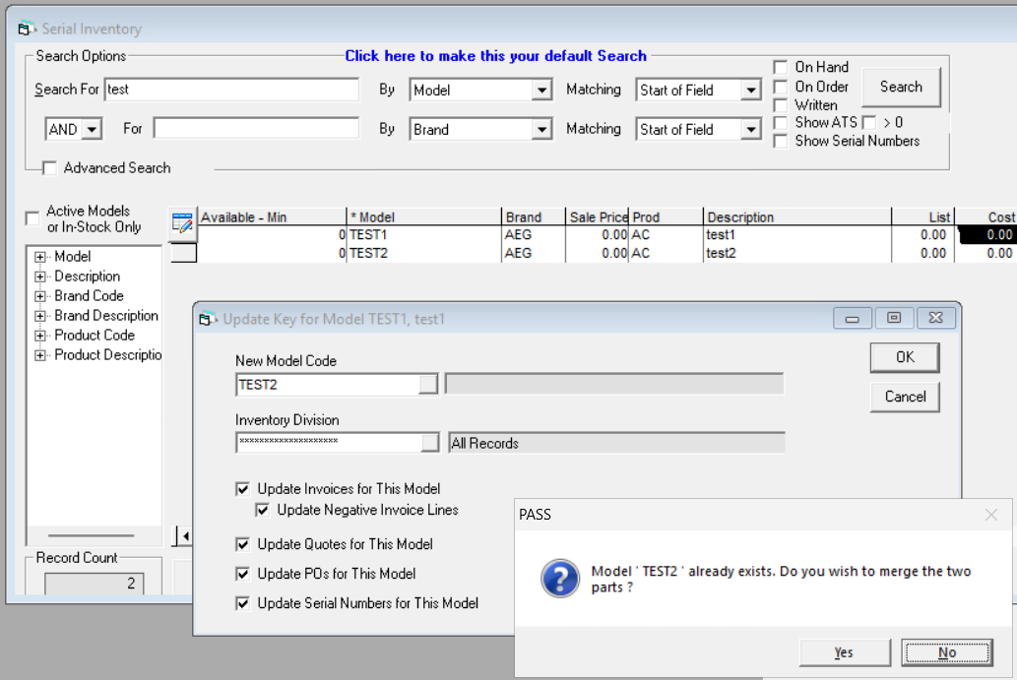
What to do with duplicates?
Merge or delete

Slide 12
Using Crystal Reports
It doesn’t have to be a fancy report to be a useful report
Crystal reports are reusable – great if you do this process infrequently
Don’t try to do too much with one report. Use individual reports
Put notes to self directly in the report

Slide 13
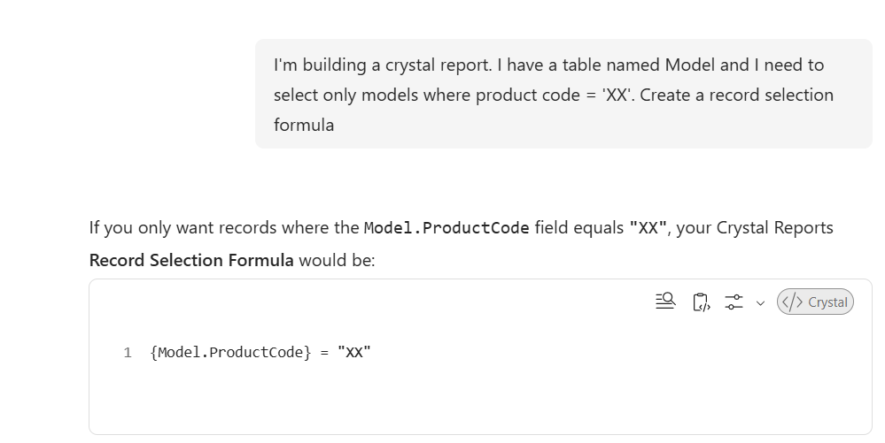
Crystal Reports – Opportunity for AI?

Slide 14
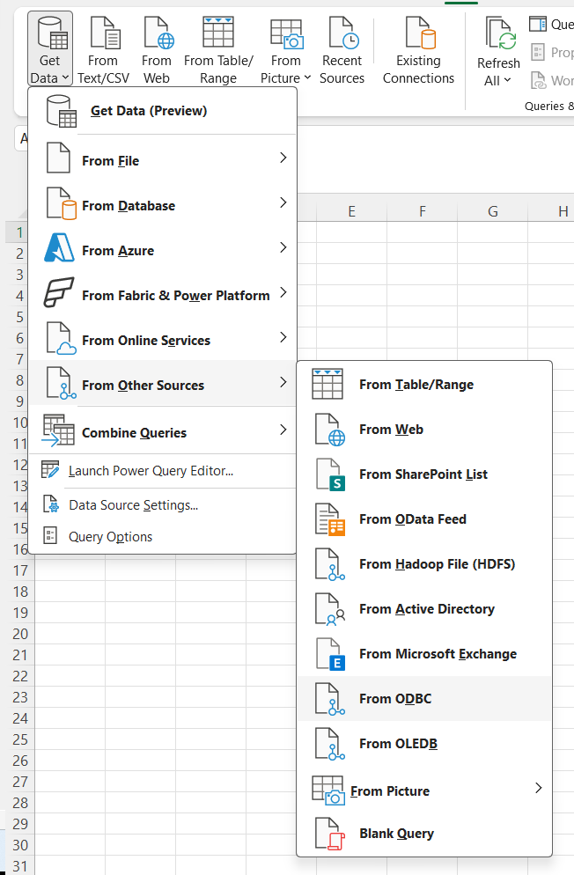
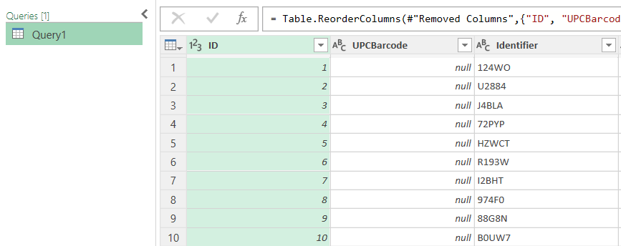
Alternative – Excel Power Query

Slide 15
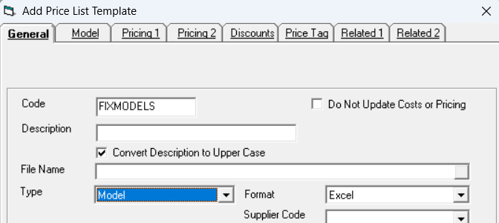
Getting data back into EPASS
Price List Template Import is a powerful tool for updating. It is often underutilized.

Slide 16
Existing import/export utilities
Purchasing > Utilities:
ETA / RDD import/export
Mass PO import/export
Serial Inventory > Utilities:
Import Field 1-5
Serial data import/export
Eco fee import/export
Model delivery import/export
Customer
Project import/export

Slide 17
Schedule the activity
Set a schedule you can reliably stick to
Delegate or split up the task
Use EPASS Reports to schedule your Crystal Reports

Slide 18
Recap
Identify data sources
Review log files
Leverage Excel
Use a Crystal Report
Reimport the data
Establish a cadence for monitoring

