Slide 1
EPASS Reports Custom Dashboards
Visualize Your Data!

Slide 2

Question!
How can you see a high-level, dynamic view of how your business is performing at every level or department?

Slide 3
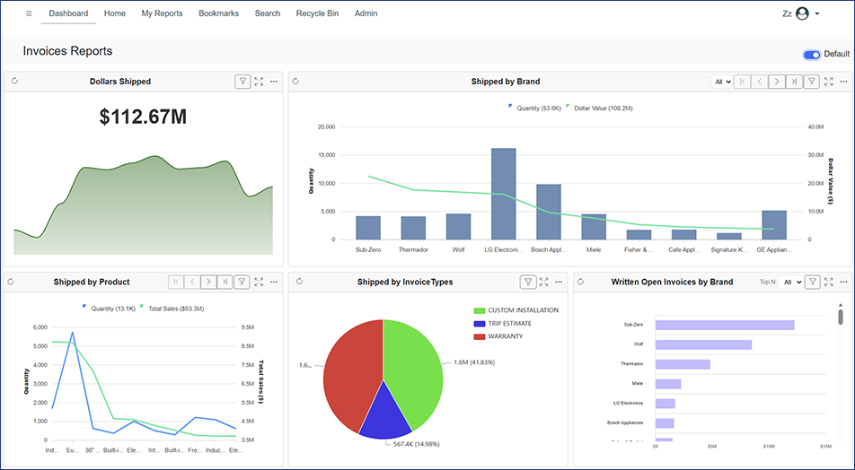
Agenda
Why Dashboards?
Getting all set up!
Let’s see a LIVE DEMO!
Creating Dashboards for different roles:
  Sales Manager
  Purchasing
  Service Department
Questions and Wrap-up.

Slide 4
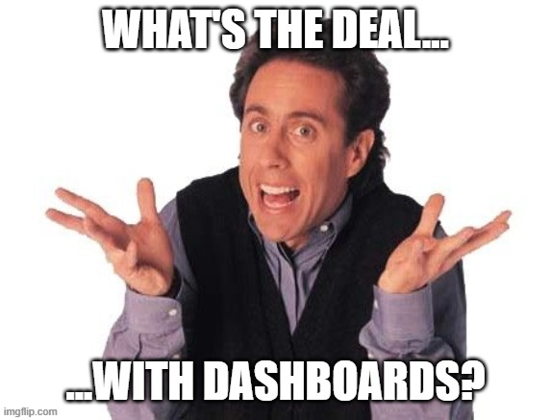
Why Dashboards?
I have reports, what more do I need?
Reports provide a narrow-focused, concentrated “deep-dive” into a single item or event.
Dashboards provide a more high-level visualization of broad amounts of data and are created to answer a single question.

Slide 5
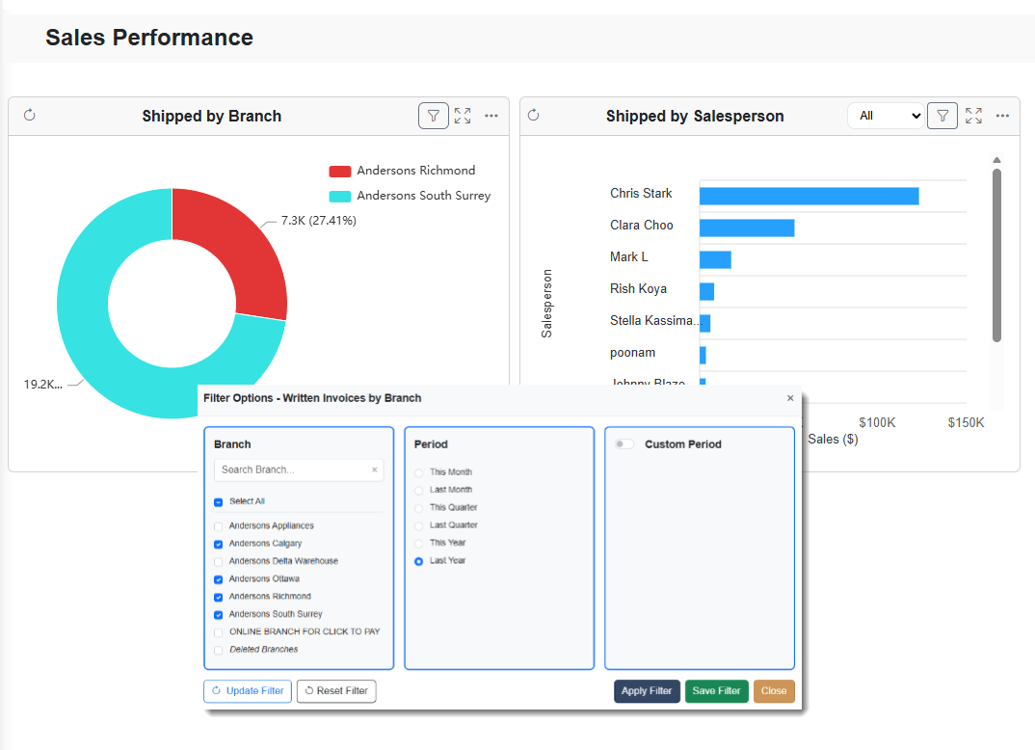
Three Main Building Blocks
The Dashboard Editor
Widgets
Filters
We’ll look at each one of these more closely in just a moment…

Slide 6

If you could put four pieces of information on a dashboard that you looked at every morning, what would they be and why?

Slide 7
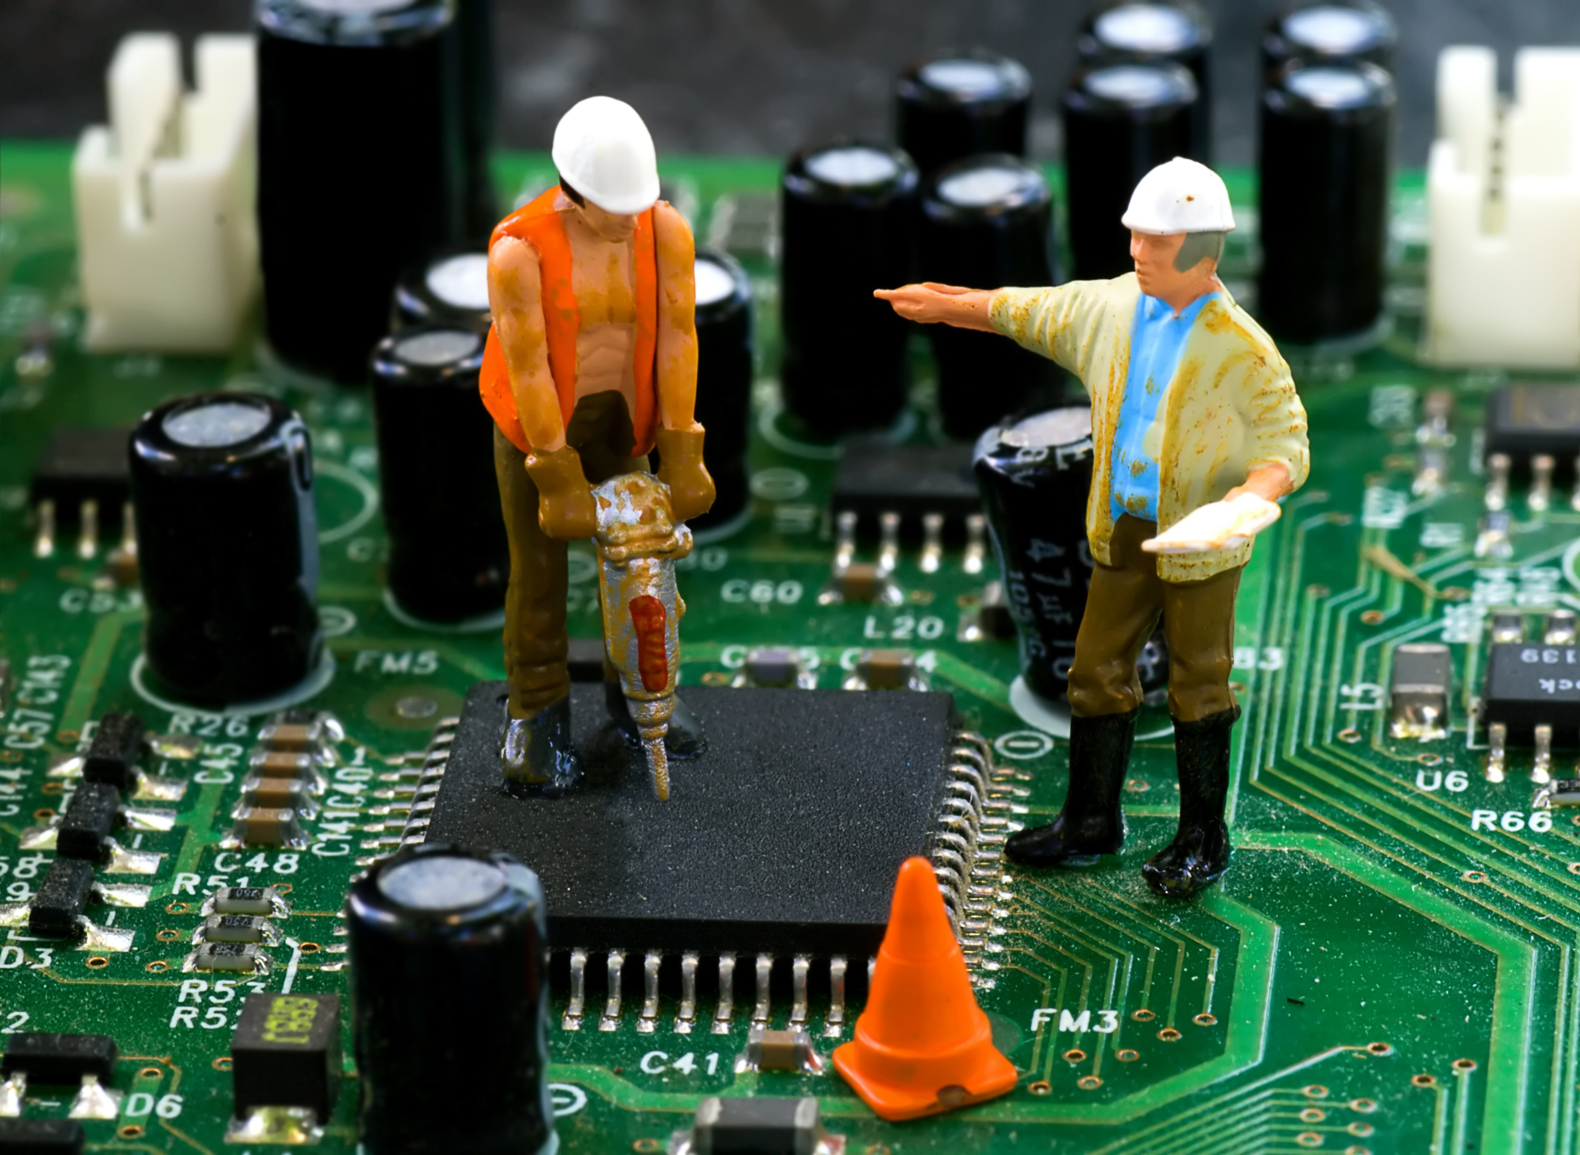
Built with Purpose
Dashboards should be built with an audience and purpose in mind, rather than just filled with available data.
Each dashboard should answer a single question. This question can be as broad or specific as you want.
A dashboard should be a platform for people to make better, more informed, data-driven decisions.

Slide 8
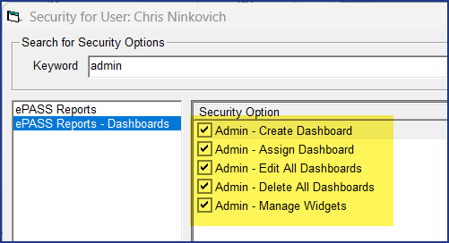
Getting set-up: Security
In User Security, under EPASS – Dashboards we have 4 administrative security options:
Create Dashboard
Assign Dashboard
Edit All Dashboards
Delete All Dashboards
Manage Widgets

Slide 9
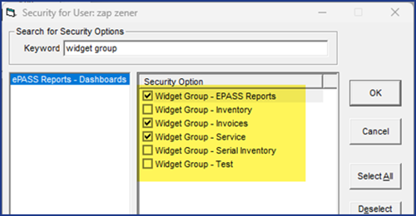
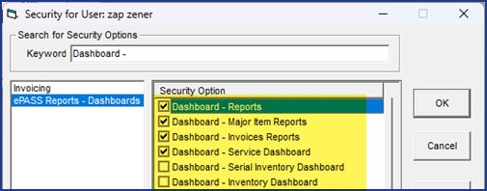
Getting set-up: Security
There are also security options that allow you to control the visibility of Dashboards that have been created as well as access to Widgets in the Dashboard Editor.
This enables you to give staff the capabilities required for their role instead of granting everyone full dashboard administration.

Slide 10


Slide 11
What we’re going to demo:
Create a New Dashboard
Add some Widgets
Adjust the Widget Filters
Rename the Widgets
Modify the Layout
Save and assign the Dashboard
Adjust security permissions of the Dashboard and Widgets

Slide 12

Let’s make some Dashboards!
As a group, let’s make a dashboard for:
Sales Manager
Purchasing
Service

Slide 13

In Summary
Unlike reports, dashboards can give you a high-level visualization of broad amounts of data.
Build with purpose and audience in mind! A dashboard should answer a question.
When it comes to data, sometimes less is more! Don’t overwhelm the audience!
Dashboards can help your staff make informed data-driven decisions. Using the built-in security options correctly can ensure the right people are getting access to the right tools.

Slide 14

ANY QUESTIONS?

