Slide 1







ENHANCEMENTS
Inventory
Payments
Purchasing
Sales
Shipping
Accounting

Slide 2
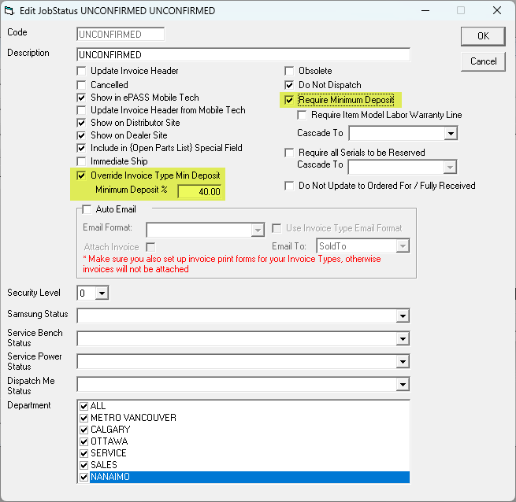
Sales
✓
Minimum Deposit Rules
Job Status-based minimum deposits with controlled overrides
Notes:
Minimum Deposit Rules
Purpose: Instead of relying on a single deposit rule for an entire invoice type, the business can require graduated deposits as you move through the job statuses
If you would like to set this up for your business, please contact support.

Slide 3
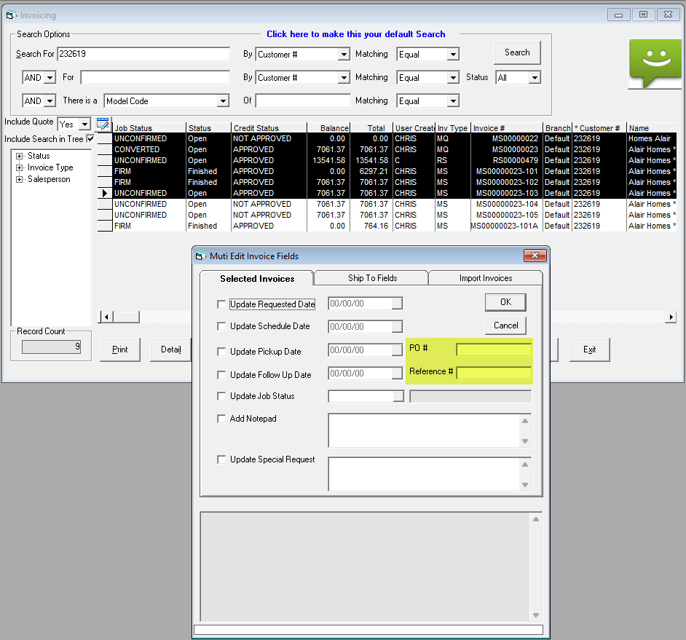
Sales
✓
Multi-Edit Invoice Fields
Bulk update PO Number and Reference across invoices.
Notes:
Bulk update PO# and References on multiple invoices

Slide 4
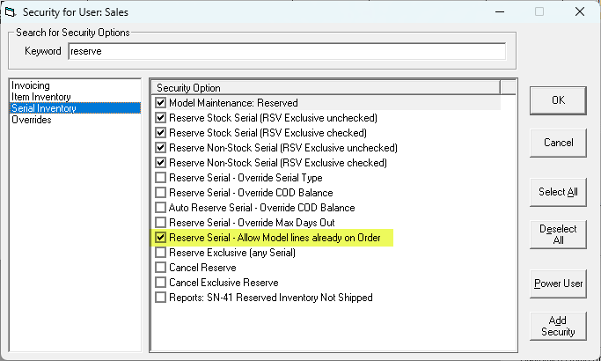
Sales
✓
Reservation Security
Blocks serial reservation when the model line is already linked to a PO.
Notes:
Reservation Security
Purpose: This enhancement improves inventory control by preventing serial reservations on model lines already tied to a purchase order.

Slide 5
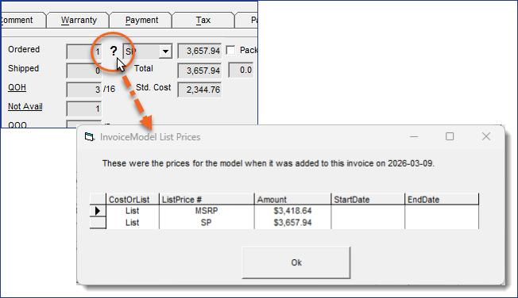
Sales
✓
Track Model List Price and Cost
Tracks List Price Code and price history; supports required List Price and Cost selection
Notes:
Model List Price & Cost
Purpose:
Tracks the history of model list price and cost.

Slide 6
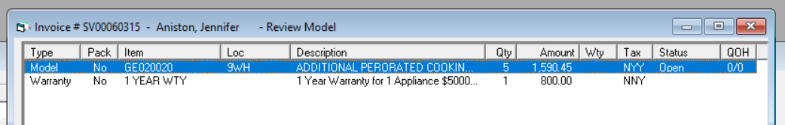
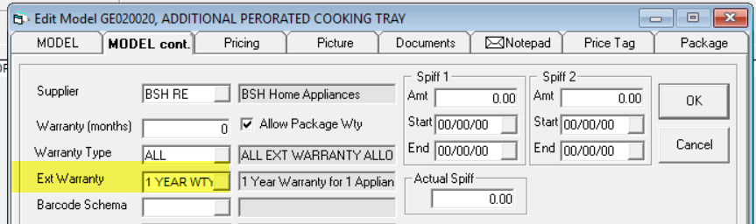
Sales
✓
Warranty by Quantity
Creates one warranty record for each model quantity.

Slide 7
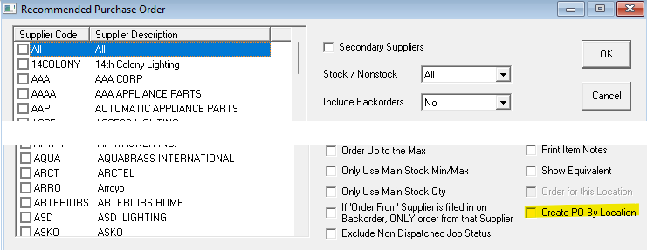
Purchasing
✓
Create PO By Location - PO12
Creates separate purchase orders grouped by supplier and location
Notes:
Immediate Ship QOH
Purpose: This enhancement improves inventory visibility and demand planning by focusing the OE-04 report on immediate-ship inventory that is not already committed to customer orders. The new “Show Immediate Ship QOH” option automatically excludes customer orders that can already be fulfilled with available, unreserved immediate-ship inventory, giving users a clearer view of true inventory shortages and actual purchasing requirements.
As a result, businesses can reduce excess stock purchases, minimize supplier PO cancellations, improve inventory utilization, and ensure available products are allocated to customers with the earliest delivery needs based on the requested delivery date, leading to better customer service and lower operational costs.

Slide 8
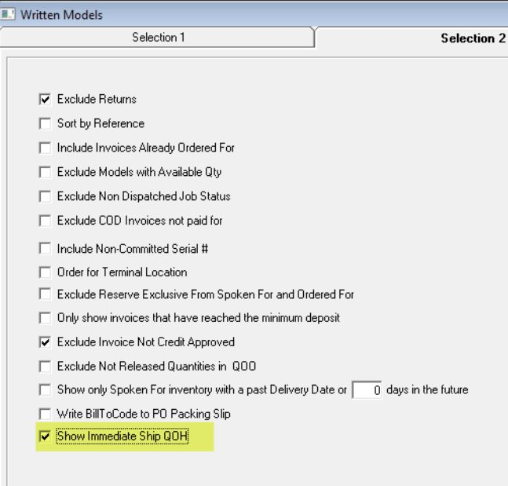
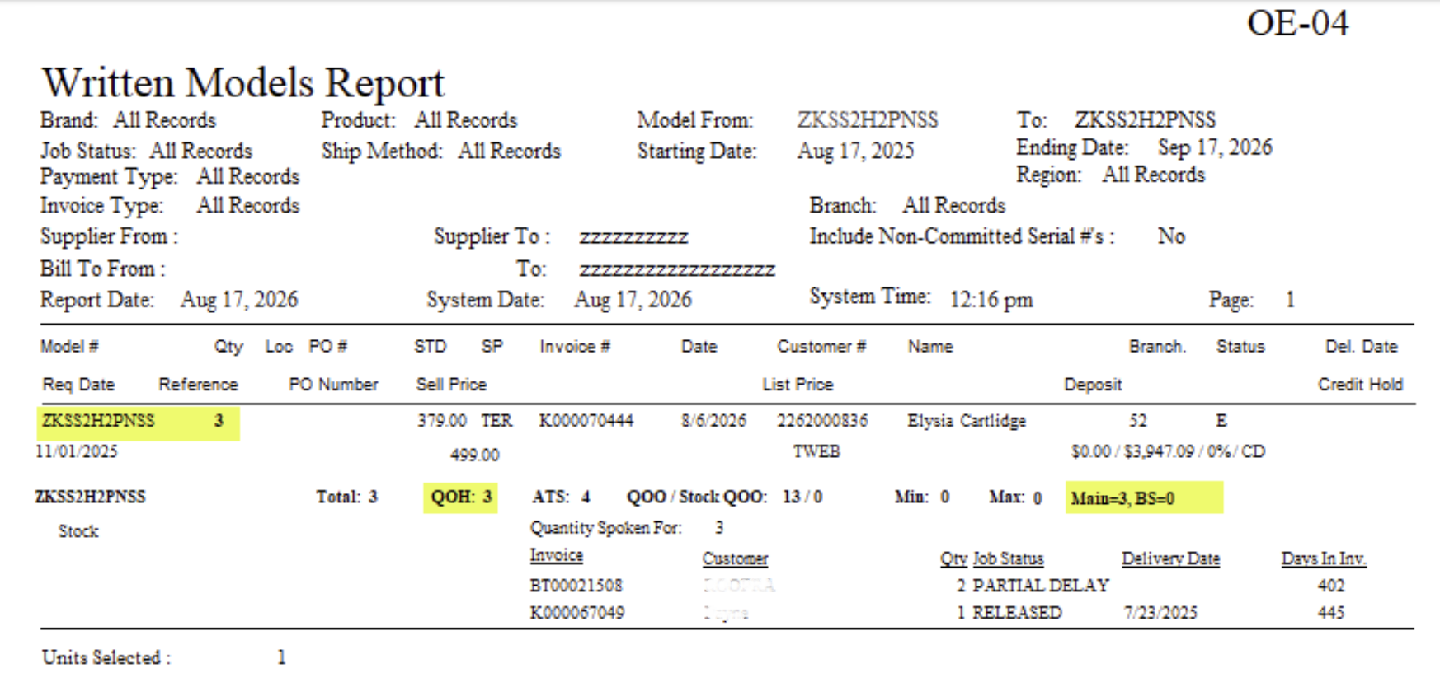
Purchasing
✓
Immediate Ship QOH
Adds allocation and reporting visibility for inventory available for immediate shipment.
Notes:
Immediate Ship QOH
Purpose: This enhancement improves inventory visibility and demand planning by focusing the OE-04 report on immediate-ship inventory that is not already committed to customer orders. The new “Show Immediate Ship QOH” option automatically excludes customer orders that can already be fulfilled with available, unreserved immediate-ship inventory, giving users a clearer view of true inventory shortages and actual purchasing requirements.
As a result, businesses can reduce excess stock purchases, minimize supplier PO cancellations, improve inventory utilization, and ensure available products are allocated to customers with the earliest delivery needs based on the requested delivery date, leading to better customer service and lower operational costs.

Slide 9
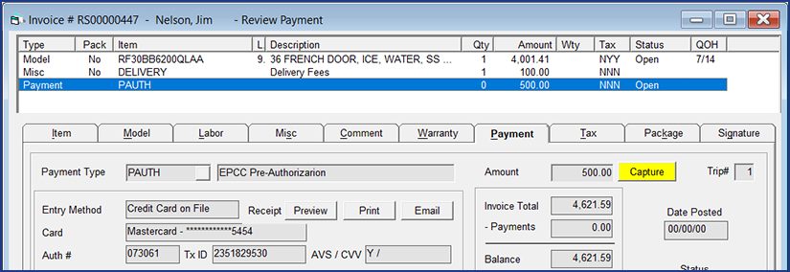
Payment
✓
Pre-Auth, Capture & Void
Supports non-zero pre-authorizations with capture and void operations.
Notes:
Pre-Auth, Capture & Void
Purpose: Provides greater flexibility in payment processing by allowing businesses to pre-authorize funds, finalize charges later, and void transactions when needed, improving cash flow control and enhancing the customer payment experience.

Slide 10
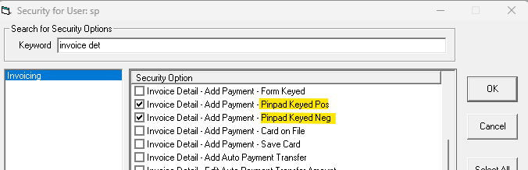
Payment
✓
PIN Pad Keyed Security
Separate access controls for positive and negative PIN Pad Keyed transactions.

Slide 11
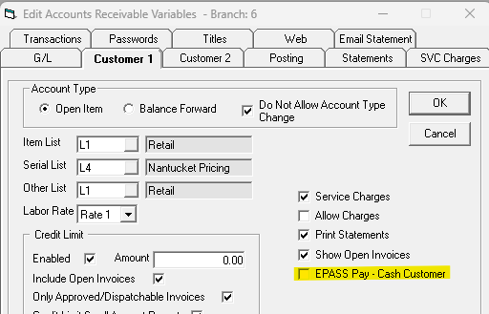
Payment
✓
Default Cash Customer
Adds a configurable default EPASS Pay Cash Customer setting in AR Variables.
Notes:
PIN Pad Keyed Security
Purpose: Improves payment security and internal controls by allowing businesses to separately manage who can process sales versus refunds, helping reduce fraud risk and unauthorized transactions.
Default Cash Customer
Purpose: Speeds up cash sale processing and reduces manual entry by automatically assigning a default cash customer, improving efficiency and consistency in AR workflows.

Slide 12
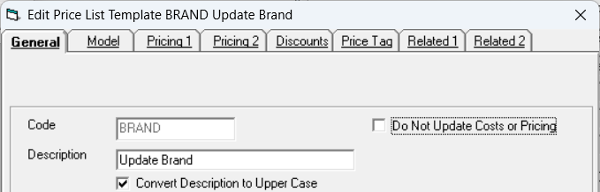
Inventory
Added 14 fields, bin-location imports, improved layouts, and location synchronization.
✓
Expanded Price List Template

Slide 13
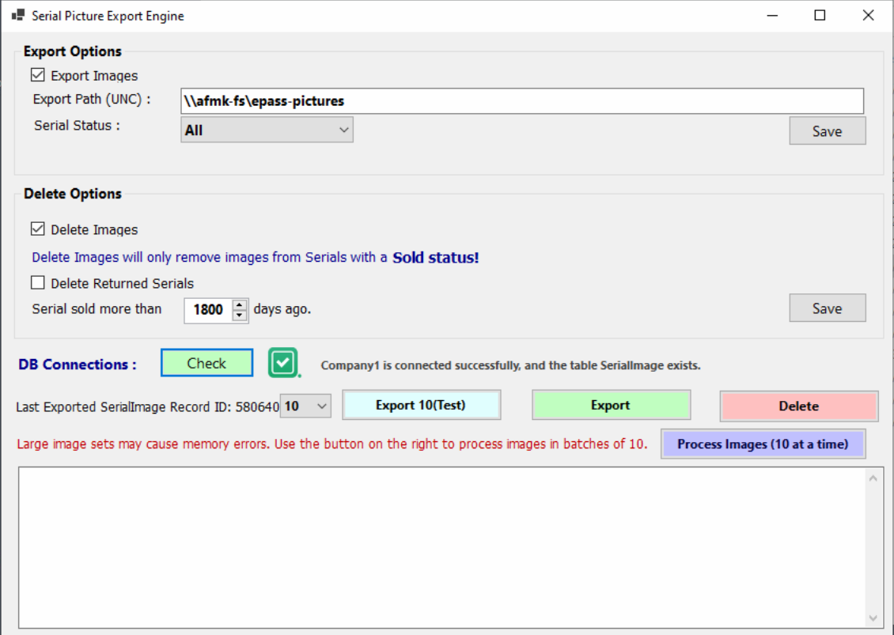
Inventory
✓
Serial Image Management
Export Serial Images from EPASS

Slide 14
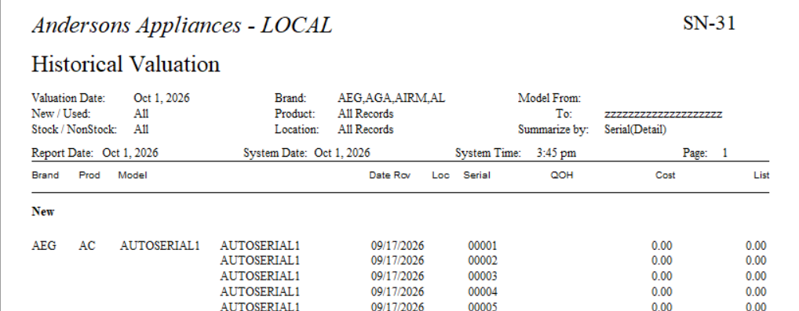
Inventory
Reduced SN-31 Historical Valuation run time from hours to minutes.
Updated logic to pull from ModelAudit (historical) instead of Serial.Cost (current) for more consistent results
✓
SN-31 Performance

Slide 15
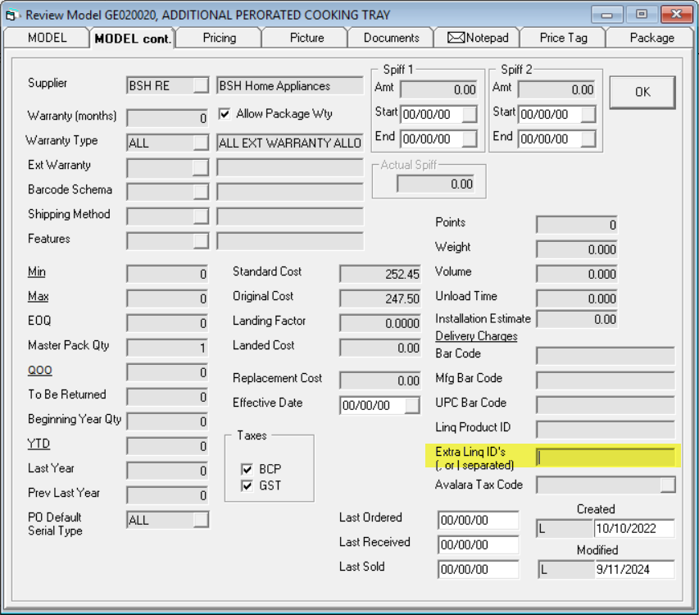
Inventory
✓
Extra LINQ IDs
Extends AVB Custom Fields export to support additional LINQ product IDs
(Notify Support of intent to use this)

Slide 16
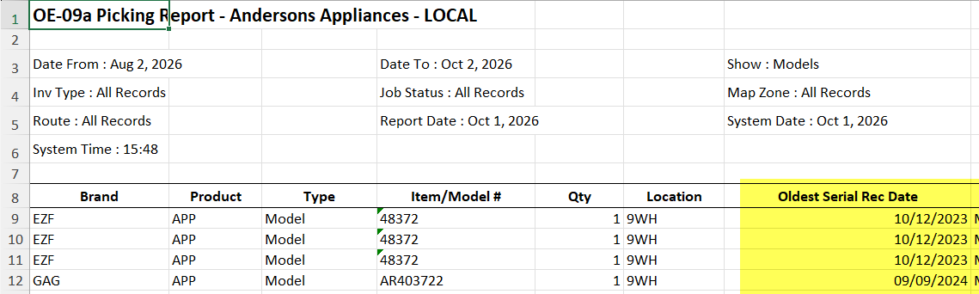
Shipping
✓
OE-09A Picking Report Enhancement
Added the oldest serial received date to the Excel export, regardless of reservation status.

Slide 17
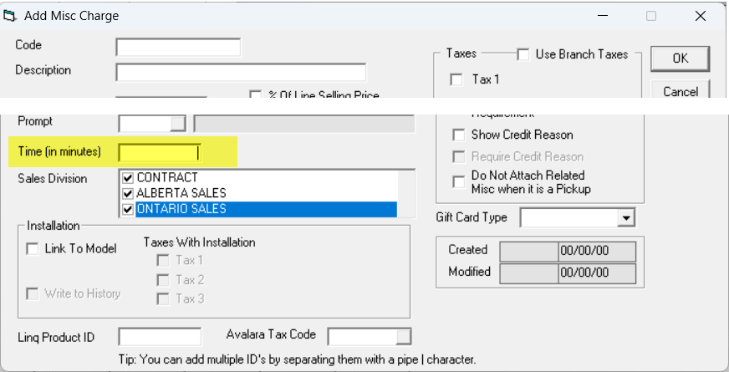
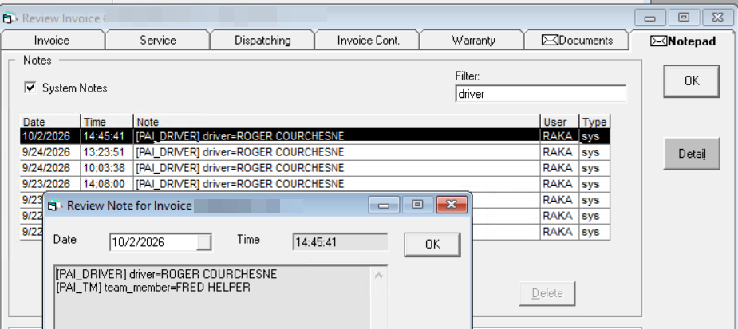
Shipping
Package AI Enhancements
Improved service-time calculations and added team-member and driver details to the invoice notepad.
✓

Slide 18
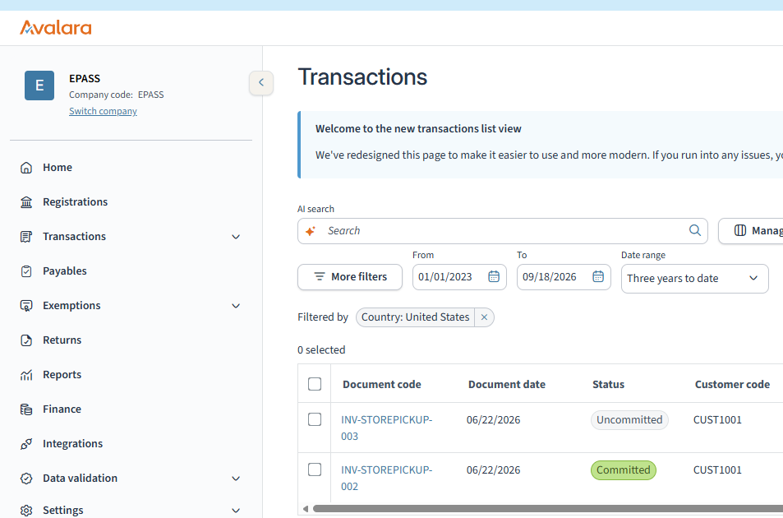
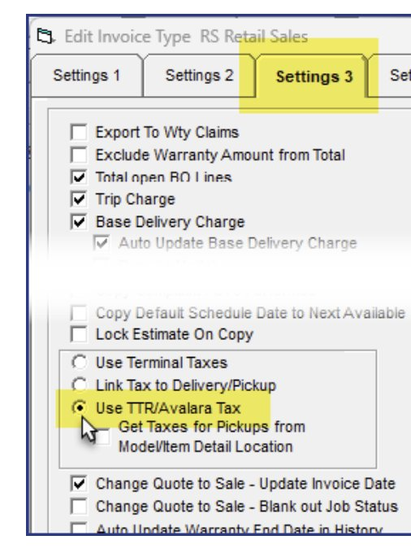
Accounting
✓
Avalara Tax Enhancement
Improved tax configuration, invoice synchronization, transaction processing, and reporting.
https://help.epass.software/help/Integrations/AvaTaxConfigurationGuide/

Slide 19
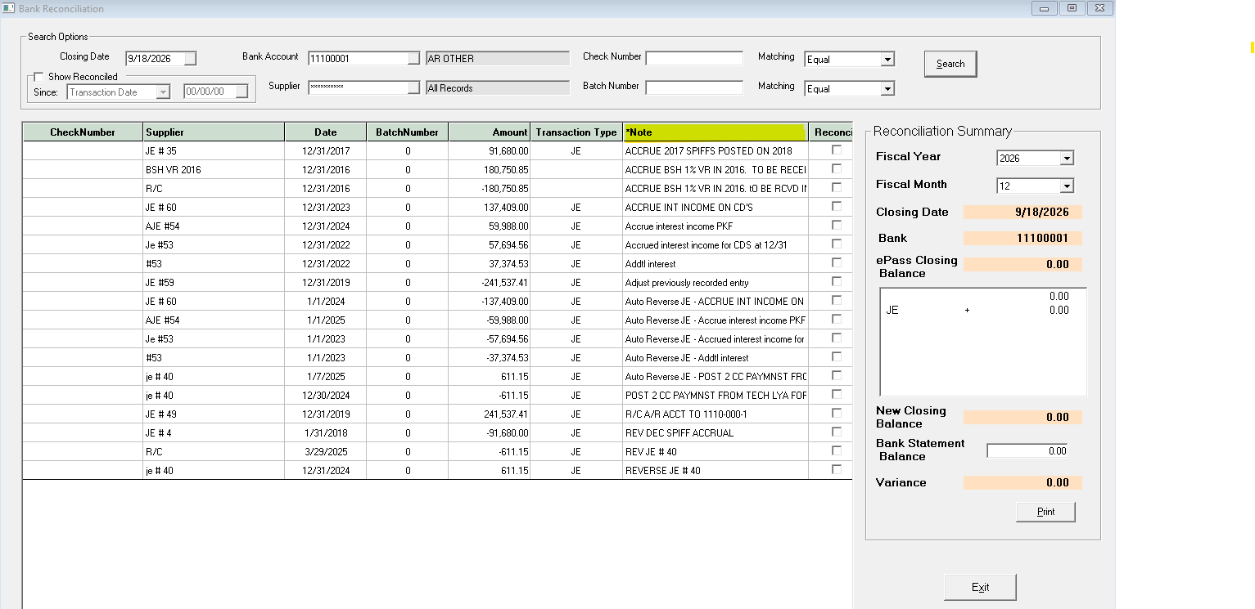
Accounting
✓
ACH Payment-Type Notes
Appends ACH payment-type descriptions retrieved from AR History.

Slide 20
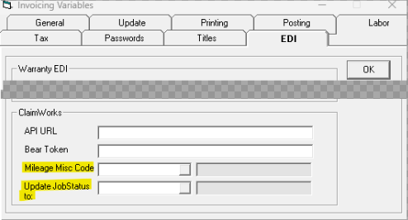
Accounting
Added configurable mileage export and automatic Job Status updates after claim submission.
✓
ClaimWorks Enhancements

Slide 21
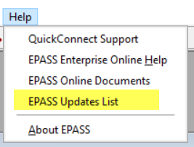
Full list of updates
Access the full updates list any time from the EPASS Help menu
✓
EPASS Updates List

